Slide 1

An Explainable Ensemble Framework for Air Quality Index Prediction Using TimeGAN-Inspired Preprocessing and Hybrid Deep Learning Models
School of Computer Science and Engineering
Department of Computer Science and Engineering
Submitted By: Priyal Singhal
23FE10CSE00106
Supervised By: Dr. Praneet Saurabh

Slide 2
Outline
Introduction
Literature Review
Problem Statement
Proposed Solution
Objectives
Results

Slide 3
Introduction
Air pollution is a critical public health crisis India has some of the world's most polluted cities
The Air Quality Index (AQI) converts pollutant concentrations (PM2.5, PM10, NO₂, SO₂, O₃) into a single health-risk score
Accurate AQI forecasting helps hospitals prepare, schools plan, and policymakers intervene on time
Real-world AQI time-series have three core challenges:
Up to 54% missing values due to sensor failures
Nonlinear, non-stationary interactions between multiple pollutants
Traditional ARIMA : assumes linearity; LSTM : black-box; XGBoost : no temporal memory
This paper proposes an XAI Ensemble Framework solving all three challenges simultaneously

Slide 4
Literature Review
AR and ARIMA models were among the earliest methods used for AQI prediction due to their simplicity and interpretability. These models performed well for linear and stationary data but failed to capture nonlinear and volatile AQI patterns.
Random Forest (RF) was introduced by Breiman and later applied to AQI prediction, showing improved accuracy over linear models by learning nonlinear relationships. However, RF lacks temporal memory, limiting its effectiveness for time-series forecasting.
Support Vector Machines (SVM) were widely used for AQI classification and regression. While they achieved high accuracy on small datasets, their scalability and real-time performance were limited due to high computational complexity.
Long Short-Term Memory (LSTM) networks, proposed by Hochreiter and Schmidhuber, significantly improved AQI prediction by capturing temporal dependencies in pollutant time-series data. LSTM models consistently outperformed traditional ML approaches for short-term forecasting.
CNN-LSTM hybrid models were proposed to enhance performance by combining spatial feature extraction with temporal learning. Studies reported higher stability and accuracy compared to standalone CNN or LSTM models.
Extreme Gradient Boosting (XGBoost), introduced by Chen and Guestrin, demonstrated strong performance in modeling nonlinear AQI trends and sudden pollution spikes. Hybrid models combining XGBoost with LSTM or ARIMA further reduced prediction errors.

Slide 5
Literature Review
TimeGAN, proposed by Yoon et al. (2019), addressed missing and incomplete time-series data by learning the underlying temporal distribution and generating realistic sequences. This approach significantly improved data recovery and prediction robustness.
Recent hybrid frameworks, such as TimeGAN combined with signal decomposition and deep learning models, achieved state-of-the-art AQI prediction performance, confirming the effectiveness of generative data recovery.
Explainable AI (XAI) techniques like SHAP and LIME were introduced to interpret ML and ensemble AQI models, revealing key pollutant contributions and increasing transparency.
Research gap: Existing models either focus on accuracy or interpretability, but very few integrate generative data recovery, ensemble learning, and explainability into a single AQI prediction framework.

Slide 6
Problem Statement
To develop an accurate, robust, and interpretable Air Quality Index (AQI) prediction framework capable of handling missing data and complex temporal–nonlinear patterns in real-world air quality datasets.

Slide 7
Objectives
01
Missing Data Handling
02
Temporal Modelling
TimeGAN-inspired imputation preserving temporal distribution (up to 54% missingness)
LSTM captures long-range seasonal AQI dependencies via gated memory cells
03
Nonlinear Pattern Learning
04
Ensemble Fusion
XGBoost models complex interactions between SO₂, NO₂, RSPM, SPM features
Dynamic R²-weighted ensemble combines both models — no manual tuning required
05
Explainability (XAI)
06
XAI-Enhanced Performance
SHAP for XGBoost + Gradient Sensitivity for LSTM — transparent predictions
Top 10 SHAP features retrain both sub-models — 54.7% RMSE improvement

Slide 8
Proposed Methodology
The framework incorporates a TimeGAN-based imputation mechanism to handle missing and irregular time-series data, along with two complementary models: LSTM for capturing temporal dependencies and XGBoost for modeling nonlinear relationships between features.
The approach begins with collecting real-world AQI data, including pollutant concentrations such as PM2.5, PM10, NO₂, SO₂, and O₃, along with relevant meteorological parameters like temperature and humidity.
Data preprocessing is performed to handle missing values, remove noise and inconsistencies, normalize feature ranges.
A TimeGAN-inspired generative model is applied to impute missing values while preserving the temporal characteristics and distribution of the original data.
The processed dataset is then transformed into fixed-length time-series sequences, which are split into training, validation, and testing sets to enable proper model training and evaluation.
An LSTM model is initialized and trained to learn temporal patterns and sequential dependencies in AQI data, allowing it to effectively capture trends over time.
In parallel, an XGBoost model is trained on the same dataset to identify complex nonlinear relationships between pollutant levels and environmental factors.
Predictions are generated independently from both LSTM and XGBoost models, capturing different aspects of the data.

Slide 9
Proposed Methodology
These predictions are combined using a dynamic weighted ensemble strategy, where weights are assigned based on model performance.
The performance of the ensemble model is evaluated using standard regression metrics such as RMSE, MAE, and R² score to measure prediction error and model fit.
Explainability is incorporated using SHAP analysis to determine feature importance and understand the contribution of each input variable to the model’s predictions.
Additionally, temporal gradient sensitivity analysis is applied to examine how changes over time influence AQI predictions, providing deeper insights into temporal dynamics.
Important features identified through explainability techniques are further used to refine the model, demonstrating that accuracy and interpretability can be achieved together.
Various visualizations such as line graphs, bar charts, scatter plots, SHAP beeswarm plots, waterfall plots, and heatmaps are generated to analyze trends, feature importance, and model performance.

Slide 10
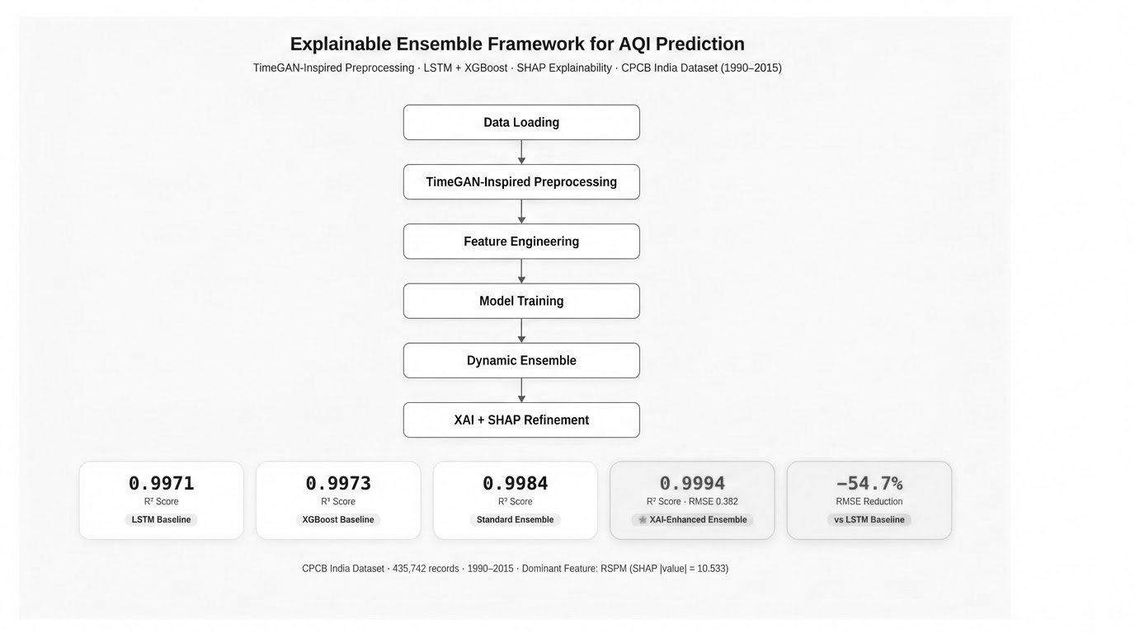
Proposed Methodology (Flowchart)
XAI Ensemble

Slide 11
Result
Training on different models:
Methods | Training Loss | Validation Loss | Training Accuracy (%) | Test Accuracy (%)
ARIMA | 0.426 | 0.489 | 83.21 | 80.35
Random Forest | 0.352 | 0.441 | 86.47 | 84.9
SVM | 0.371 | 0.408 | 87.62 | 86.5
TimeGAN | 0.182 | 0.216 | 94.88 | 95.8
Model | RMSE | MAE | R² | XAI Integration
LSTM | 0.8430 | 0.6717 | 0.9971 | None
XGBoost | 0.8110 | 0.5730 | 0.9973 | None
Ensemble (LSTM + XGBoost) | 0.6175 | 0.4769 | 0.9984 | None
XAI-Enhanced Ensemble (SHAP-guided) | 0.3817 | 0.2773 | 0.9994 | SHAP + Temporal Sensitivity

Slide 12
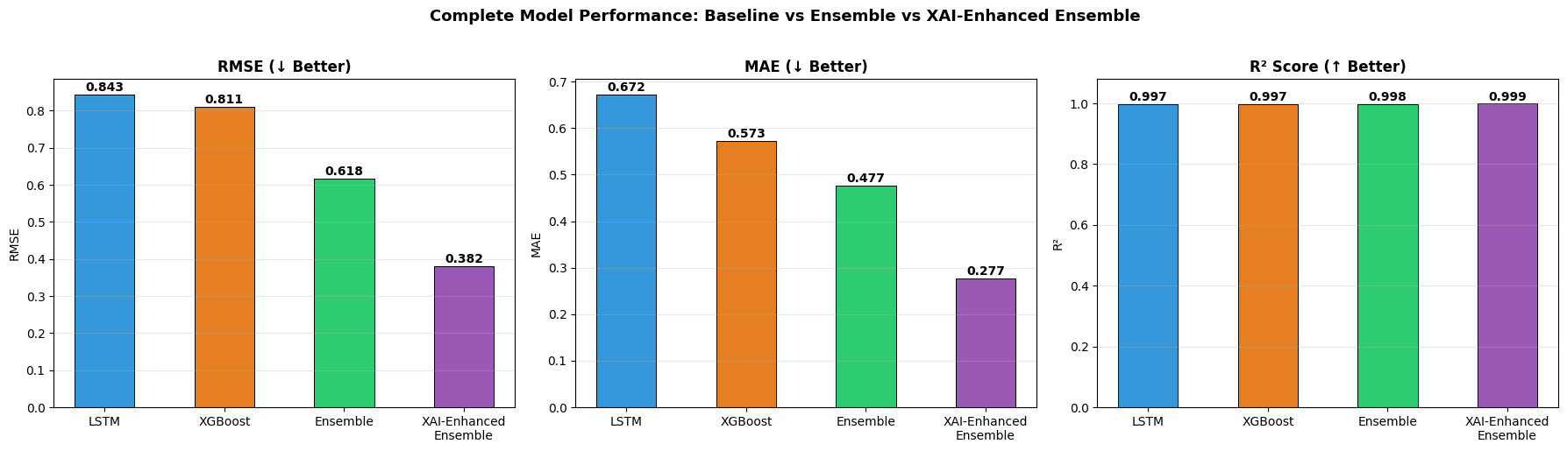
Result

Slide 13
Outcome
Research Paper (Drafted)
Patent (To be drafted)
Copyright (To be published)

Slide 14
References
United Nations, Transforming our world: The 2030 Agenda for Sustainable Development, United Nations General Assembly, New York, NY, USA, 2015.
World Health Organization, Air Quality Guidelines: Global Update 2005, WHO Press, Geneva, Switzerland, 2006.
J. Lelieveld, J. S. Evans, M. Fnais, D. Giannadaki, and A. Pozzer, “The contribution of outdoor air pollution sources to premature mortality on a global scale,” Nature, vol. 525, no. 7569, pp. 367–371, 2015.
R. D. Brook et al., “Particulate matter air pollution and cardiovascular disease,” Circulation, vol. 121, no. 21, pp. 2331–2378, 2010.
M. Grange et al., “Challenges in air quality prediction: A review,” Atmospheric Environment, vol. 231, pp. 117–130, 2020.
G. Box, G. Jenkins, G. Reinsel, and G. Ljung, Time Series Analysis: Forecasting and Control, 5th ed., Hoboken, NJ, USA: Wiley, 2015.
L. Breiman, “Random forests,” Machine Learning, vol. 45, no. 1, pp. 5–32, 2001.
C. Cortes and V. Vapnik, “Support-vector networks,” Machine Learning, vol. 20, no. 3, pp. 273–297, 1995.
S. Hochreiter and J. Schmidhuber, “Long short-term memory,” Neural Computation, vol. 9, no. 8, pp. 1735–1780, 1997.
Y. Yan, S. Yang, and Y. Wang, “A CNN-LSTM based hybrid model for air quality prediction,” Environmental Modelling & Software, vol. 128, pp. 104–115, 2020.
T. Chen and C. Guestrin, “XGBoost: A scalable tree boosting system,” in Proc. 22nd ACM SIGKDD Int. Conf. Knowledge Discovery and Data Mining, San Francisco, CA, USA, 2016, pp. 785–794.
S. M. Lundberg and S.-I. Lee, “A unified approach to interpreting model predictions,” in Proc. 31st Int. Conf. Neural Information Processing Systems (NeurIPS), Long Beach, CA, USA, 2017, pp. 4765–4774.
M. T. Ribeiro, S. Singh, and C. Guestrin, “Why should I trust you? Explaining the predictions of any classifier,” in Proc. 22nd ACM SIGKDD Int. Conf. Knowledge Discovery and Data Mining, San Francisco, CA, USA, 2016, pp. 1135–1144.
A. Adadi and M. Berrada, “Peeking inside the black box: A survey on explainable artificial intelligence (XAI),” IEEE Access, vol. 6, pp. 52138–52160, 2018.
J. Yoon, D. Jarrett, and M. van der Schaar, “Time-series generative adversarial networks,” in Proc. 33rd Int. Conf. Neural Information Processing Systems (NeurIPS), Vancouver, BC, Canada, 2019, pp. 5509–5519.
Z. Wu et al., “Hybrid models for AQI prediction based on signal decomposition and machine learning,” Atmospheric Pollution Research, vol. 10, no. 6, pp. 1927–1937, 2019.
Y. Zhang, S. Wang, and J. Wang, “Air quality forecasting using hybrid deep learning models,” IEEE Transactions on Industrial Informatics, vol. 16, no. 6, pp. 3771–3781, 2020.
S. Liu et al., “Explainable machine learning for air quality prediction,” Environmental Science & Technology, vol. 55, no. 18, pp. 12220–12230, 2021.
A. Verma and V. Sharma, “Air Quality Index (AQI) Prediction Using Machine Learning and Deep Learning Approaches,” International Journal for Research in Applied Science & Engineering Technology (IJRASET), vol. 13, no. 5, May 2025, ISSN: 2321-9653.

Slide 15
Thank You

